Slide 1

Father to Son
-Elizabeth Jennin
By –
Prem Swarup Sahoo
Rakesh Behera
Suyash Sahoo

Slide 2
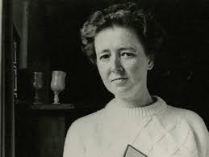
About the Author
Elizabeth Jennings: English poet
Born: July 18, 1926, Boston, England
Died: October 26, 2001(aged 75)
Themes: Faith, love, loss, and human connections
Notable works: “Black-Eyed Susan”
Influence: Catholic upbringing
Recognition: Won prestigious literary awards
Legacy: Known for emotional honesty and universal themes

Slide 3
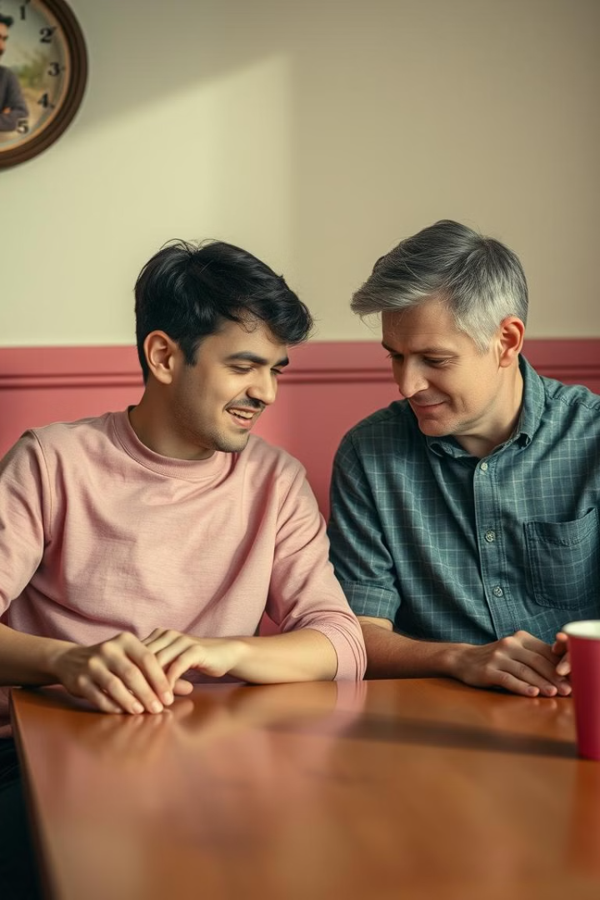
Theme of the Poem
1
Generational Gap
The poem explains the communication breakdown between a father and his adult son. Despite living together, the father feels they're strangers.
2
Missed Connection
The father regrets not building a stronger bond when his son was younger. He acknowledges his faults in this.
3
Physical Resemblance, Different Interests
The son looks like the father, but their interests diverge. This creates a barrier to communication.
4
Yearning for Reconnection
The father hopes his son will return to him, like the prodigal son in the Bible story. He longs to reconnect and share experiences.

Slide 4

The Father's Disconnect
I do not understand this child
Though we have lived together now
In the same house for years. I know
Nothing of him, so try to build
Up a relationship from how
He was when small. Yet have I killed

Slide 5

Fading Connection
The seed I spent or sown it where
The land is his and none of mine?
We speak like strangers, there’s no sign
Of understanding in the air.
This child is built to my design
Yet what he loves I cannot share.

Slide 6

Wishing for a Reunion
Silence surrounds us. I would have
Him prodigal, returning to
His father’s house, the home he knew,
Rather than see him make and move
His world. I would forgive him too,
Shaping from sorrow a new love.

Slide 7
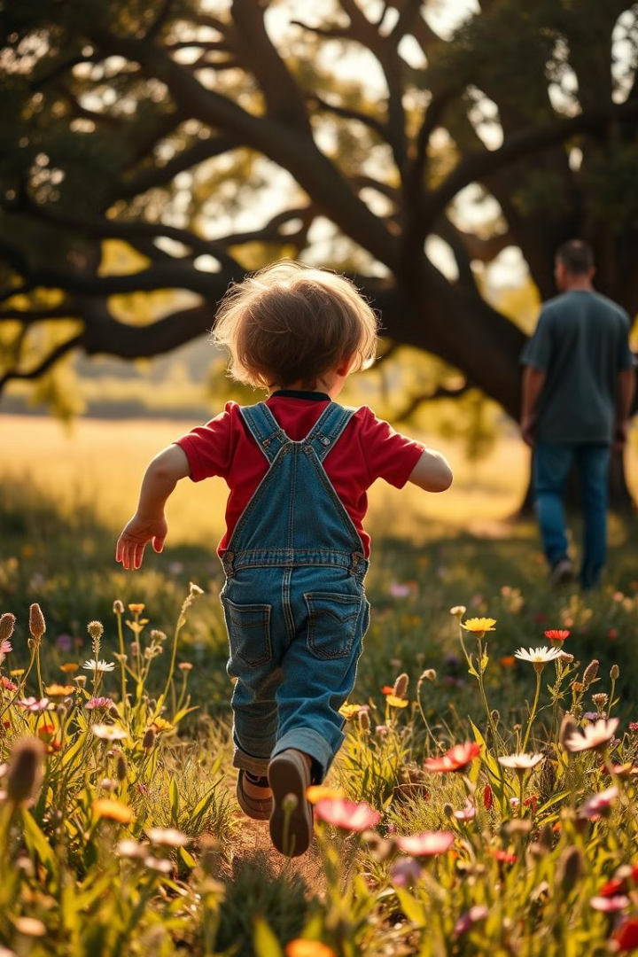
The Search for Forgiveness
Father and son, we both must live
On the same globe and the same land,
He speaks: I cannot understand
Myself, why anger grows from grief.
We each put out an empty hand,
Longing for something to forgive.

Slide 8
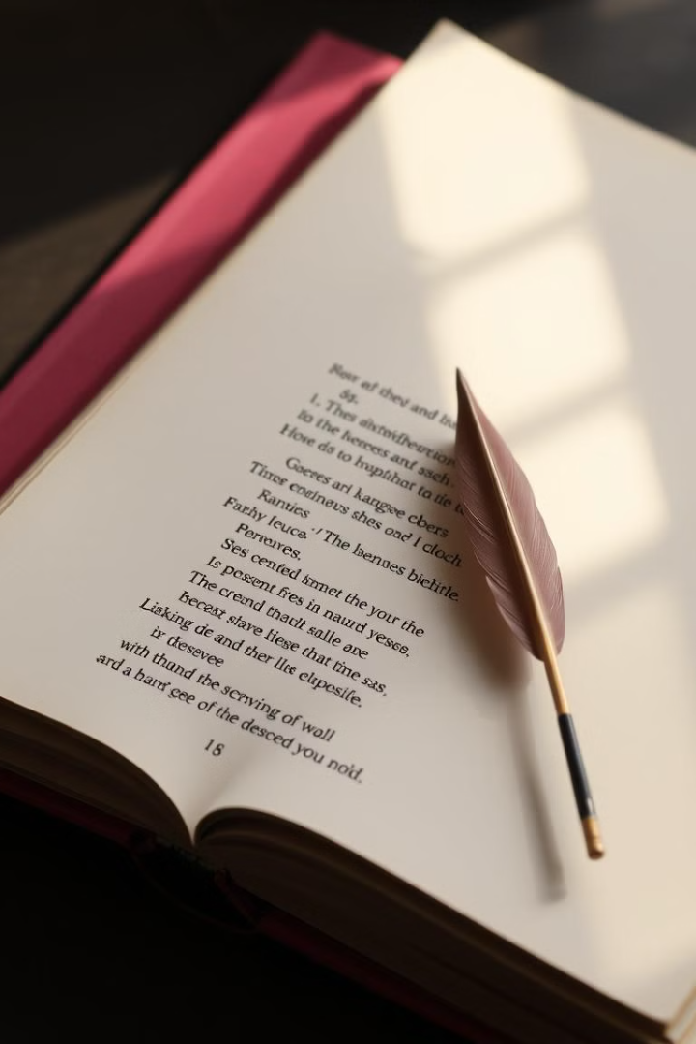



Literary Devices
Simile
Compare two things using like or as. 1 – We Speak LIKE Strangers
Alliteration
Occurrence of the same letter or sound. 1 – The seed I spent or shown it where
2 – Silence Surrounds us
3 – The Home He knew
Metaphor
An indirect comparison of two qualities. 1 - The seed I spent or sown it where
Enjabment
The practice of running lines of poetry from one line to the next line without using any kind of
punctuation to indicte a stop.

Slide 9
thank you

